Slide 1



Website tour
Section 2a: Placing a Web Order

Slide 2
Website Structure

Slide 3
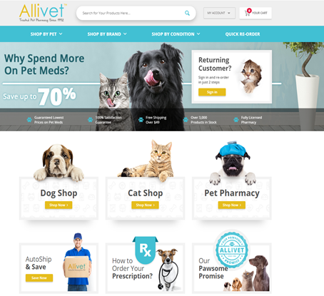
Homepage intro
Welcome to Allivet.com!
As a customer service agent, the website will be one of your biggest resources to help service our clients.
In this section you will learn:
How to navigate the website from the customer's point of view
How to use the search function
How to place an order as a customer
How our shipping time frames function

Slide 4
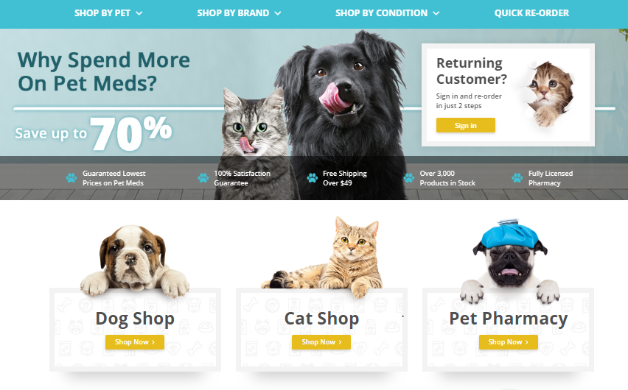
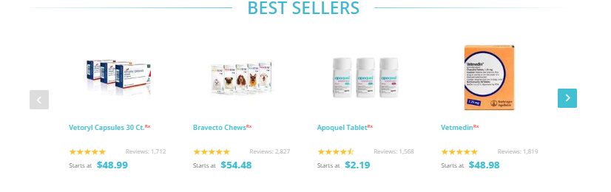
Tabs and Categories
As the customer you will notice how the homepage is broken up into three different tabs/categories in order to make the search easier for our customers.
The top tabs are separated by species and popular product categories.
The middle tabs highlight our most popular species for easy access.
The last tab will allow you to scroll through our best-selling items.
Notes:
Transitional Arrows
Arrow 1- Point 1.
Arrow 2- Point 2.
Arrow 3- Point 3.

Slide 5
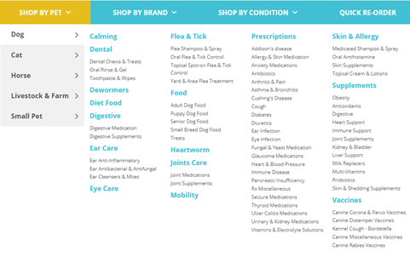
Tabs and Categories
Subtabs
When you select one of the top tabs a drop-down menu will appear.
This dropdown is further broken down to subtabs based on the specie, or product tab that was selected.
This will be further broken down to the categories within the subtabs.
Notes:
Example:
You (the client) are looking for a joint supplement as Max is getting older and you want to make sure he is getting all the support he needs.
I click on “Dog Care”
View the “Dog Supplement” category
Click on “Dog Joint Supplements”
All of Allivet’s “Dog Joint Supplements” will populate
The same concept applied for the middle section by popular species.

Slide 6
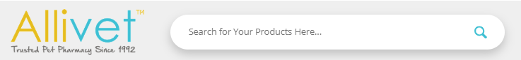
Search Function
Most customers have a general idea of what they are looking for. Our site has a search bar to make it easier for our customers to find what they need.
This search bar is located at the top of the homepage.
Auto suggestions will be provided based on what is being entered in order to avoid spelling errors of medication

Slide 7

Search Function
General vs. Specific
There are two types of search methods:
General searches are wide searches that need to be broken down to smaller categories.
Specific searches are for people looking for a specific product by name.
General | Specific
Dog Food | Taste of the Wild Lamb
Vaccines | Canine Spectra 5
Heartworm Preventative | Heartgard Plus
Notes:
Table is used as an example list for the next slide

Slide 8
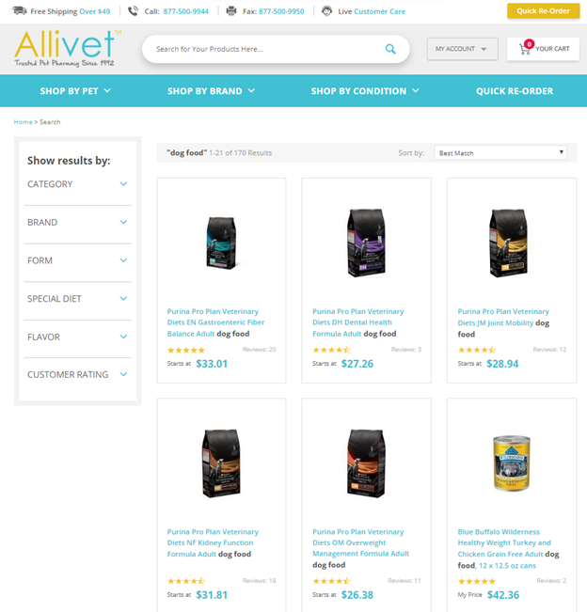
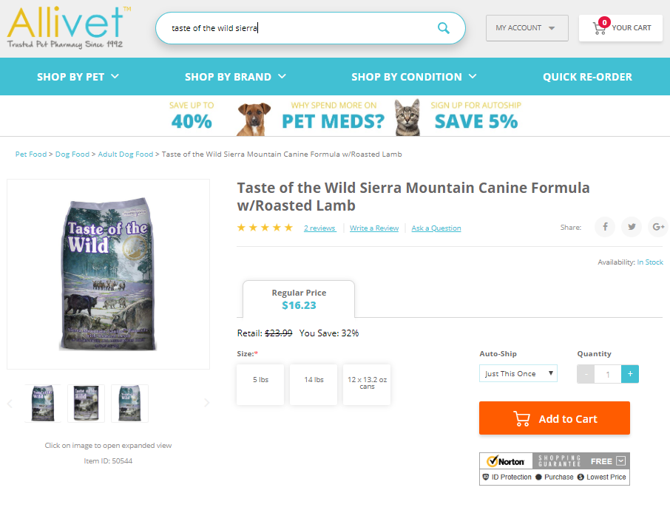
Search Function
General vs. Specific
Notes:
General
By entering a general search the website is going to produce all the items which correlate to your search.
This will have you scrolling through all the different products we carry.
Examples
Dog Food
Are you looking for size specific food?
Are you looking for a specific brand?
Are you looking for a special dietary need?
Specific
When you specify with the exact item you are searching for your results are going to be a lot less cluttered.
Product name-Taste of the Wild Lamb
Results- Image of exact product and product name

Slide 9
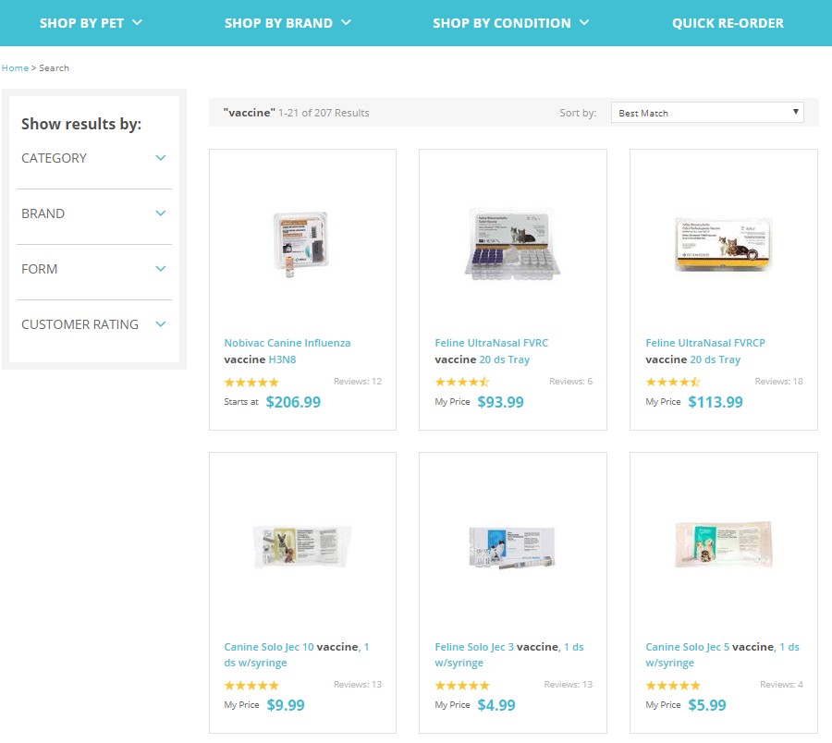
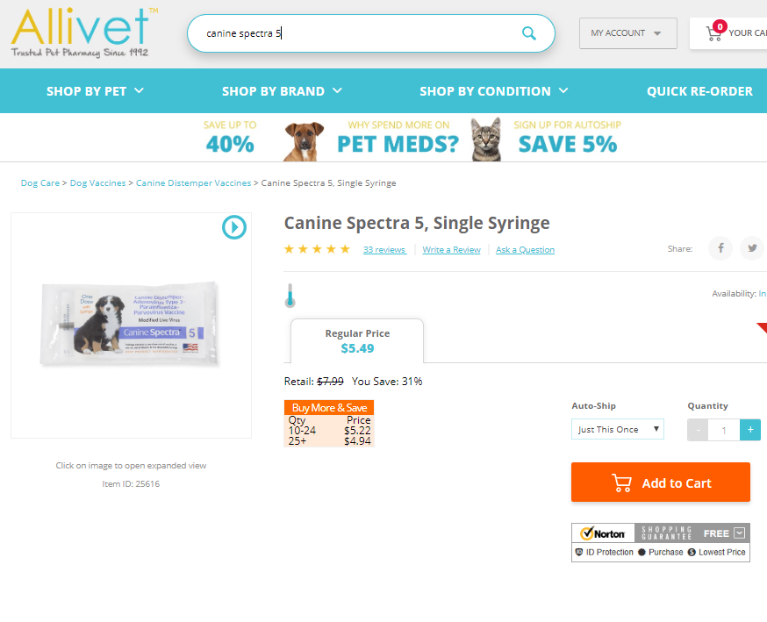
Search Function
General vs. Specific
General vs Specific
Notes:
General Examples Cont.
Vaccines
Are you looking for a dog, cat, or horse?
Do you want something specifically covered?
Are you looking for a single vial or a tray?
Specific
Example
Product name- Canine Spectra 5
Results- Image of exact product and product name

Slide 10
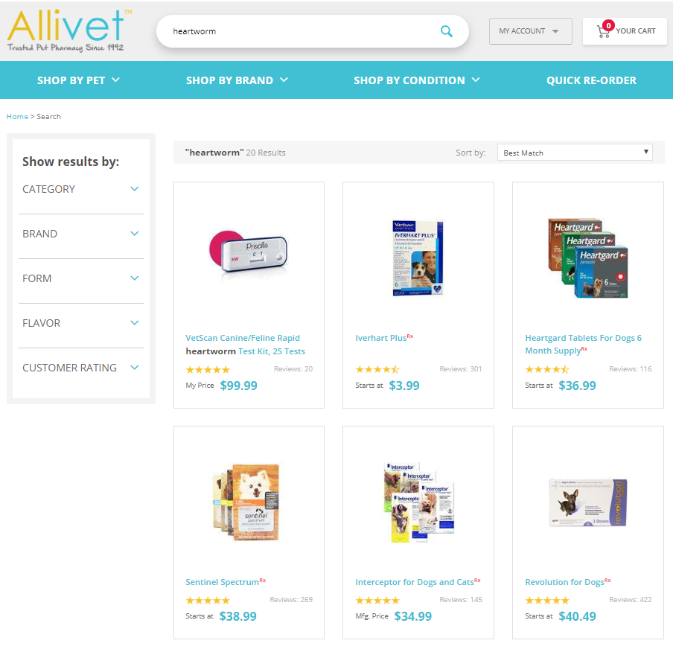
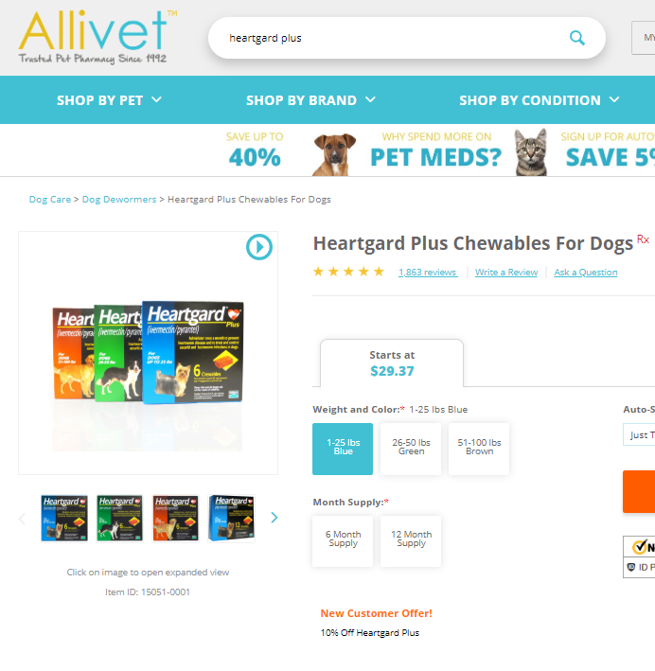
Search Function
General vs. Specific
Notes:
General Examples Cont.
Heartworm Preventative
Are you looking for a cat or a dog?
Are you looking for an oral or a topical formula?
All these questions will allow you a more specific search while using the process of elimination
Specific
This as a client helps to not overwhelm you with all the items we have to offer.
Product name- Heartgard Plus
Results- Image of exact product and product name

Slide 11
Search Function
Exercise
In this exercise, you will complete 5 general vs specific searches to see what you come across.
Flea and Tick vs Frontline
Shampoo vs Aloedine Shampoo
Electrolytes vs Summer Games Plus
Feline Urinary vs Epakitin
Cat Treats vs Greenies Feline Dental

Slide 12
Page BreakDown

Slide 13
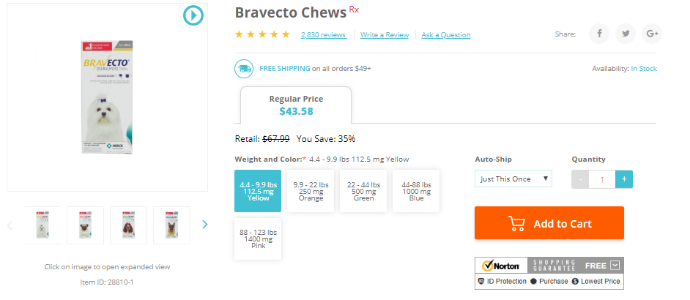
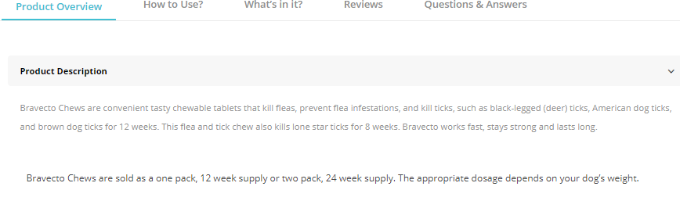
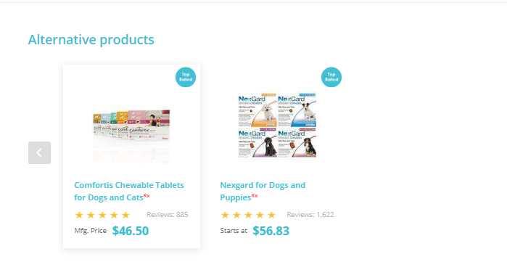
Product page Intro
Once you have selected an item, a variety of information will be provided on the page:
Item Image
Item Description
Product Details
Pricing
Alternative Products
Product Suggestions

Slide 14
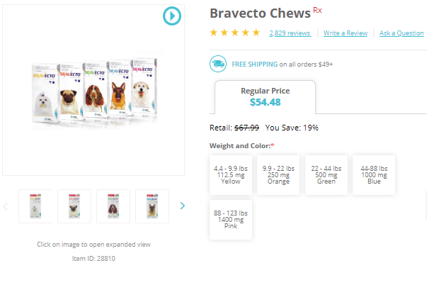
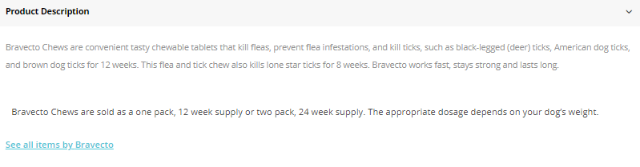
Product Details
Notes:
Transition Arrows Included
Arrow 1 = Item Photo
Item Photo
Item Number
This is what you will use when working on Admin (internal system)
Item number will change upon specified selection
Social Media Links
This is not always the packaging that the customer will receive
Packaging May vary by the product and manufacturer
Arrow 2 = Item description
Item Name
Item Rating
Will include the total number of reviews
Link in order to leave a review
Item Description
This is a brief overview of the item
Indicator Icons
Prescription Required
Reward Points Qualifier
Cold Shipped Item
Ground Ship Only
Free Shipping
Export Only
Arrow 3 = Pricing
Price
Some prices will need to be indicated at the point of sale
Prices will change depending on either the dose or weight selected
Weight/Dose Selection
Some items will need to be specified by a dose or by a weight range
Autoship
Clients can set an item as a reoccurring order based via this selection
Add to Cart Button

Slide 15
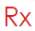



Icons
Image | Meaning
 | Prescription Required
 | Qualifies for Reward Points Earned
 | Requires Cold Shipping
 | Export ONLY item Can NOT be shipped within the U.S.
 | Item Qualifies for Free Shipping Even Below $49.00
 | Can ONLY be Shipped Ground NO EXPIDITING
Notes:
The website has different icons throughout the site indicating special requirements per item.
This will allow the client to understand if they will need to do anything specific with the items they are placing on their order.
All icons can be clicked on for a full explication of what they mean.

Slide 16
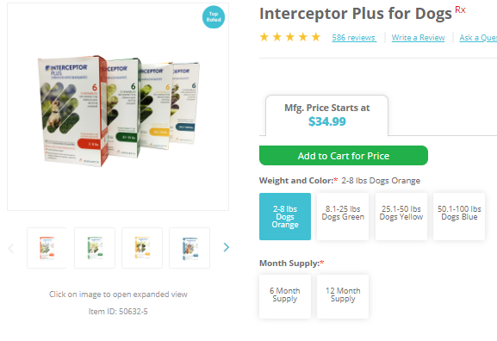
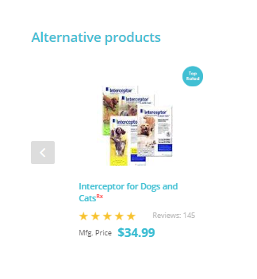
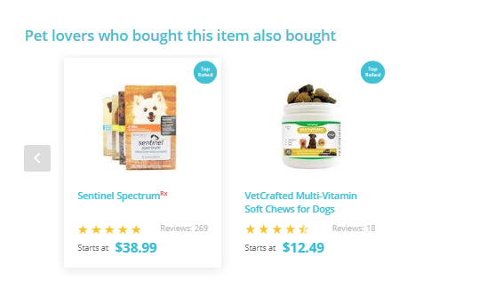
Suggestions and Alternatives
Notes:
Transition Arrows
Arrow 1 = Suggested Products
- Will appear DIRECTLY below the main product description
These are listed products that our system collects based on other users shopping habits
You can scroll through the different products via the blue left and right arrows
Arrow 2 = Alternative Products
Will appear DIRECTLY below the main product’s pricing area
These are typical suggestions of similar products
Should a main item be out of stock or on a back order clients can view an alternative here
- Some alternatives are generic medications

Slide 17
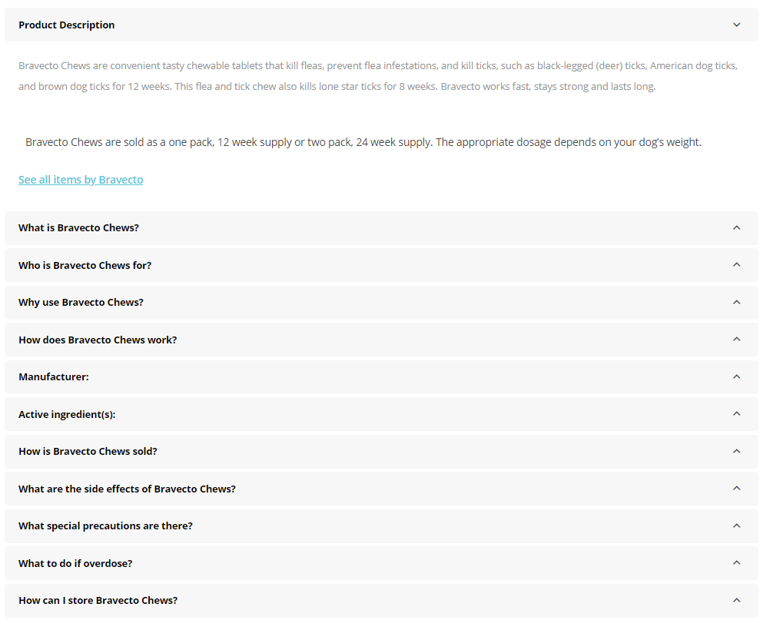
Product Table
There is a table for every product found on the website.
This is a great source of information as there are dropdown menus with any question a customer may have.
There are tabs that help maneuver to the most common questions and facts related to the selected product.
Has hide away options in order to create less clutter.
Notes:
This is where you will want to look for any detailed questions a customer may have

Slide 18
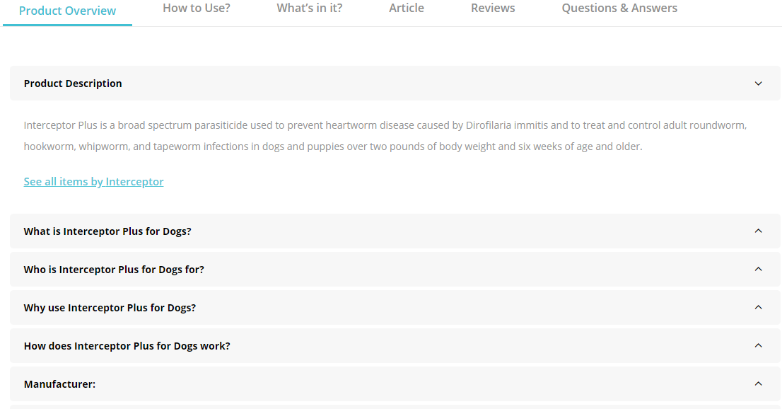
Tabs
Product Overview
There are 5 main tabs providing general information:
Product Overview
How To Use?
What’s In It?
Reviews
Questions & Answers
Notes:
Transition Arrows per bullet point indicating each tab
Product Overview
- Holds all the general information regarding the selected product.
- This information is displayed in a dropdown menu form
- The first drop down will automatically be selected when in this tab as it is the general description of the product.

Slide 19
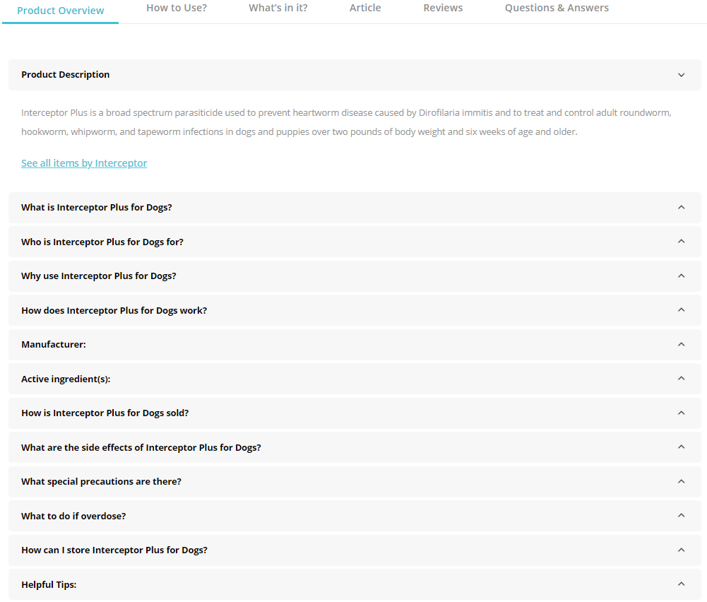
Dropdown Menus
Notes:
Each product has the same dropdown categories
What is (name of product)?
Who is it for
Will specify all the species this product is intended for
Why use it
How it works
Manufacturer
Different manufactures can be listed as some items we carry more than one brand of
Active Ingredient(s)
How it’s sold
This will vary based on product
Could specify with or without manufacture packaging
Could specify as individual product vs bottle or box
What special precautions are there?
What to do if overdose
How to store
Helpful tips

Slide 20
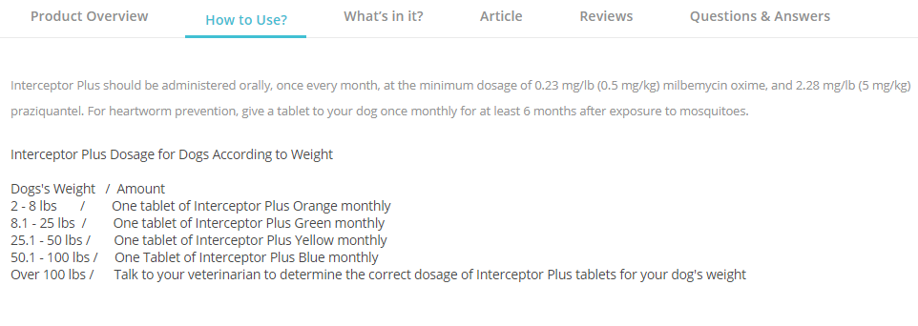
Tabs
How To Use?
Notes:
How To Use?
- Instructions on how to use a selected product
- Many prescription items will only have “Use as Directed by Veterinarian” as they are specialized doses.
- Over the counter items will have dosing instructions
- Rx items will not have any dosing instructions as these are items that will need to be given specified directions by your veterinarian.
- The site will direct you to contact your local vet.

Slide 21
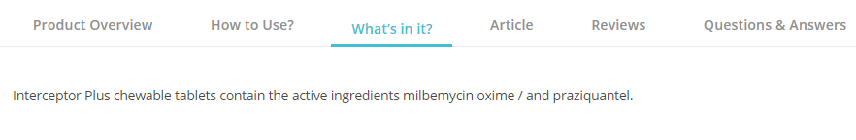
Tabs
What’s In It?
Will reflect the active ingredients
Some products will be separated into both active and inactive ingredients.

Slide 22
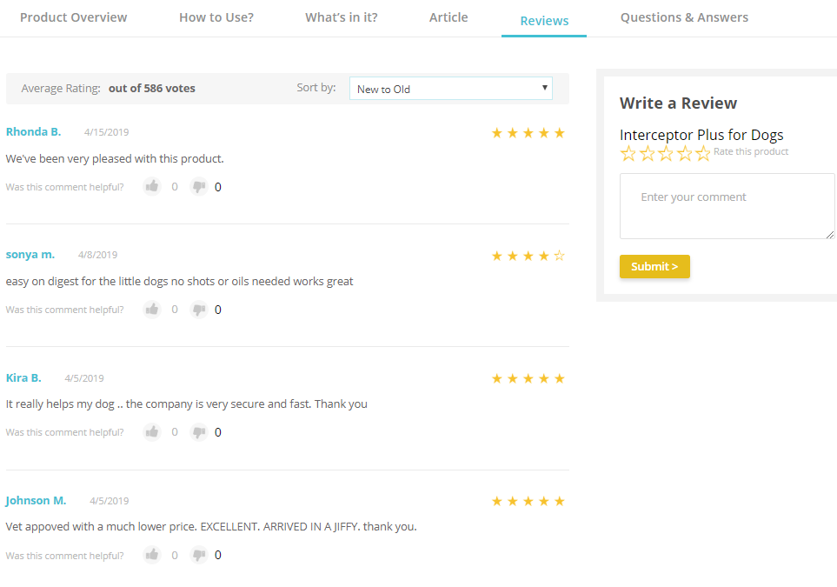
Tabs
Reviews
Notes:
Here you can view all the reviews clients have left regarding the selected product
You can also rate the product from here by clicking the blue “Click Here” button on the left hand side
You can sort through the review from:
New to Old
Old to New
Helpful to Less Helpful
Less Helpful to Helpful
High to Low Rating
Low to High Rating
Towards the right hand corner you can see how many votes/reviews were left for this product
Reviews will display:
Clients First name and last initial
The date the review was posted
The rating they gave it
And a selection for other clients to mark whether or not this review was helpful to them

Slide 23
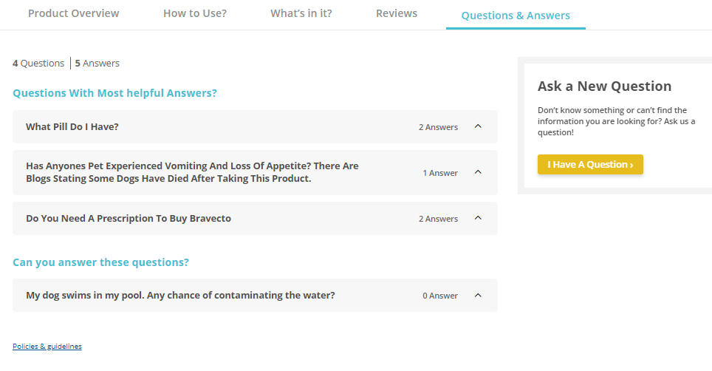
Tabs
Questions & Answers
Notes:
THIS IS NOT SOMETHING TO BE USED AS A REFFERENCE FOR CUSTOMER INQUARIES
Tabs
There are two tabs that will help a client sort through the Q&A section:
- Q&A Home
- All Q&A
Q&A Home
Shows all the Q&A’s that have been submitted by clients.
Comes up in a drop down menu form to view the question along with the answers to that specific question.
All Q&A
Has a search bar to search for a specific question or answer. You may even search with keywords.
You can Sort through the questions via:
Most recent questions
Oldest questions
Questions with the most helpful answers
Questions with the most helpful answer
Questions with the oldest answer
Questions with the most answers
Can you answer this question?
You may also ask a question by clicking the blue button on the bottom right that says “Ask a New Question”

Slide 24
Tabs
Exercise
In this exercise, you are being asked to look up 7 different products and answer the related question.
What is the star rating for Nupro Natural Supplement?
What is the item number for Elevate W.S Natural Vitamin E?
Is Azodyl a cold shipped item?
What is an alternative for Atopica for Dogs, 15 Capsules Rx?
Is Vetmedin a RX item?
What is the active ingredient in Lean Treats for Dogs, 4 oz?
What are the weight ranges for Bravecto?
Notes:
THIS IS NOT SOMETHING TO BE USED AS A REFFERENCE FOR CUSTOMER INQUARIES
Tabs
There are two tabs that will help a client sort through the Q&A section:
- Q&A Home
- All Q&A
Q&A Home
Shows all the Q&A’s that have been submitted by clients.
Comes up in a drop down menu form to view the question along with the answers to that specific question.
All Q&A
Has a search bar to search for a specific question or answer. You may even search with keywords.
You can Sort through the questions via:
Most recent questions
Oldest questions
Questions with the most helpful answers
Questions with the most helpful answer
Questions with the oldest answer
Questions with the most answers
Can you answer this question?
You may also ask a question by clicking the blue button on the bottom right that says “Ask a New Question”

Slide 25
Placing a web order

Slide 26

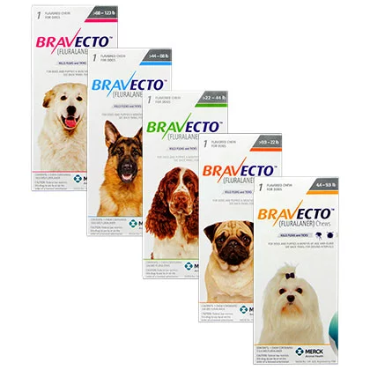
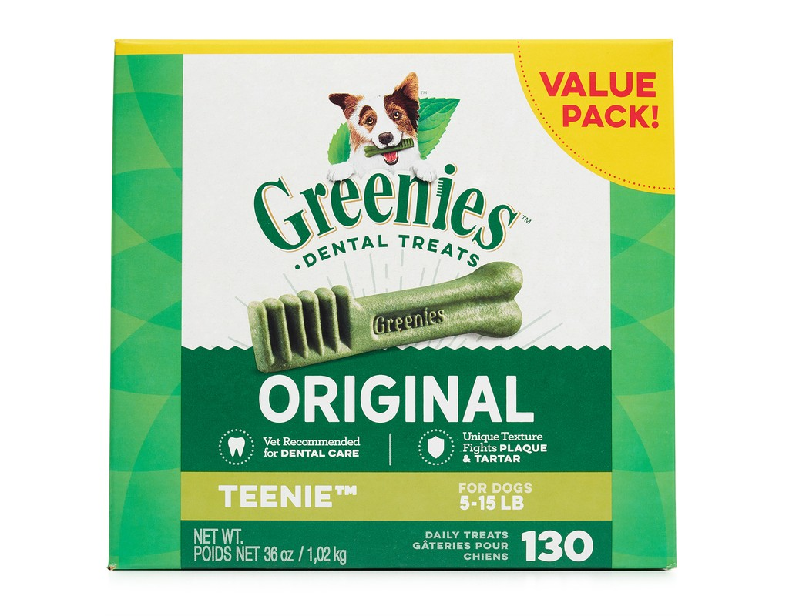
How to place an order
Here’s where the fun begins!
Placing an order through the website is very simple.
We are going to walk through the motions as a customer and place an order.
Scenario: Jasper is getting close to needing her dose of flea and tick preventative. She also is running low on her favorite dental chews.
Lets' place an order for Bravecto and Greenies.

Slide 27
How to place an order
Account Entering
In order to place any order you will need to be logged into your account.
If you do not have an account, one will need to be created.
No purchase can be made without being signed into your account.
Notes:
Customers can create an account from the check out point.

Slide 28
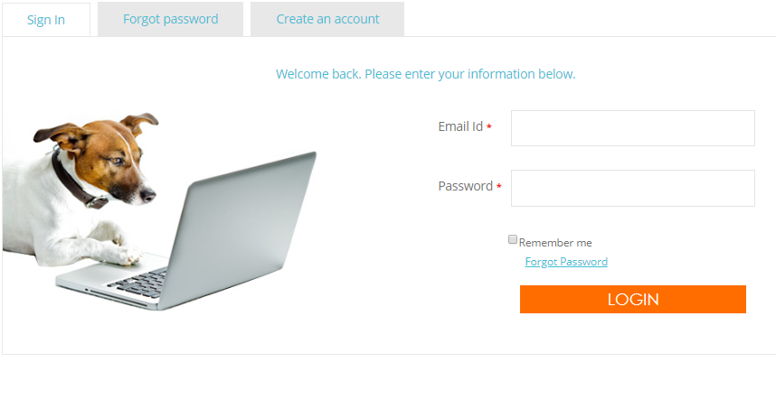
How to place an order
Account Entering
Log In
Click on the "MY ACCOUNT"
Select "Sign In" from the drop down and you will be directed to your home page.

Slide 29
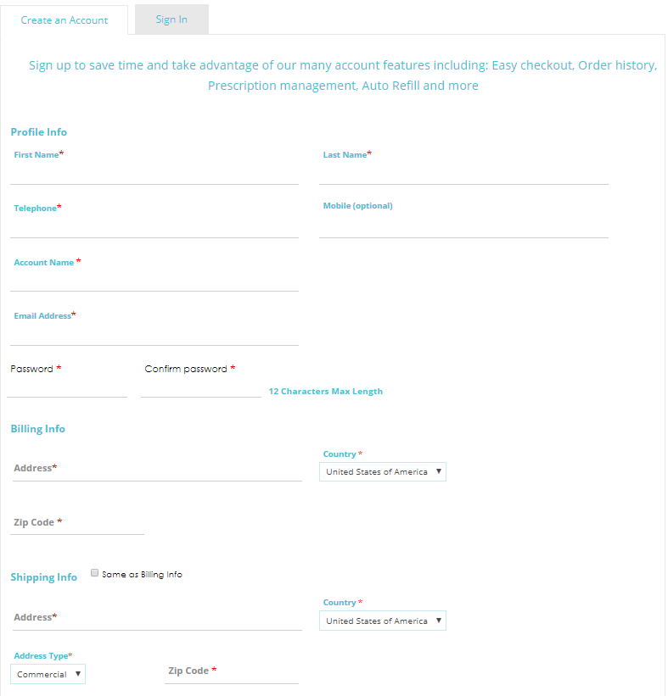
How to place an order
Account Entering
Creating a New Account
Click on the “Create an Account” tab and you will be directed to a new page to enter your profile information

Slide 30
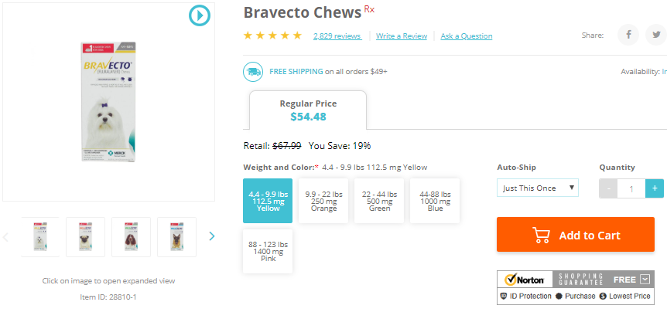
How to place an order
Adding Items to Cart
We are going to first add the Bravecto to the cart.
From the product page, select the weight range for the specified pet and add it to the cart.
Repeat for Greenies

Slide 31
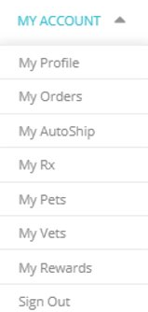
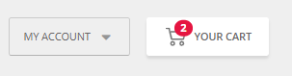
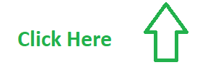
How to place an order
Shopping Cart
Now that we have completed our shopping, we will proceed to the checkout point.
You will notice "YOUR CART" in the upper right-hand corner of the page will now reflect a number the number 2.
This is an indicator that you have 2 items pending purchase in your account.
Click on "YOUR CART" to access your shopping cart.

Slide 32
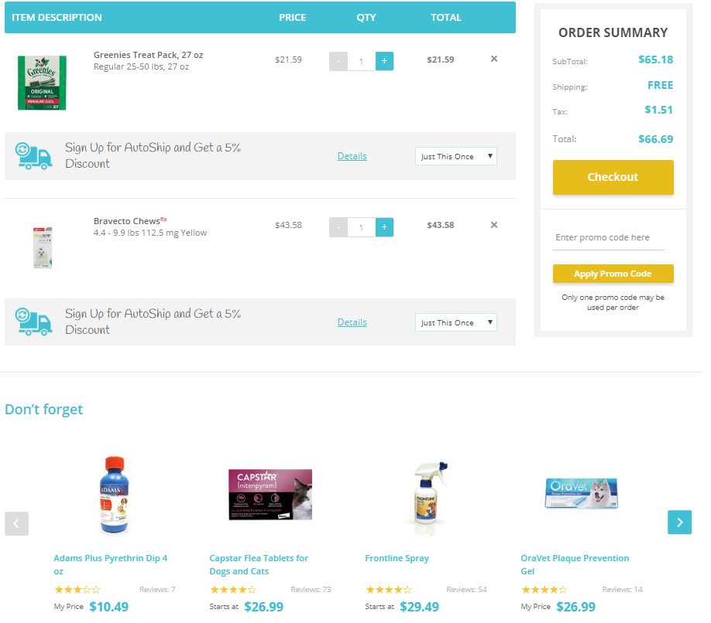
How to place an order
Shopping Cart
On the shopping cart page, you will be able to:
Adjust Quantities
Remove Items
Enter Coupons
See a General Breakdown of Order

Slide 33
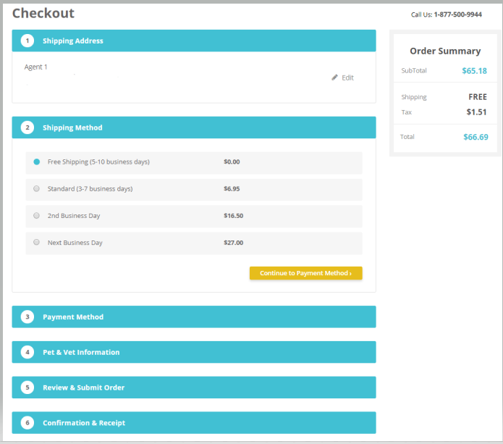
How to place an order
CheckOut Process
On the checkout page you will be able to:
Edit billing & shipping address
View Shipping Estimates
Payment method
Specify Pets (RX items only)​
Select Vet
See a General Breakdown of Order
Enter Order Notes​

Slide 34
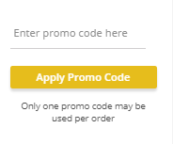
How to place an order
Coupons & Credits
Coupons
Are typically emailed as promotional codes to clients
Credits
There are two types of credits:
Store Credits: Are coupons issued by customer service to the clients for numerous reasons
Reward Points: Points earned for shopping with Allivet
Notes:
Rules
As coupons can be added to orders they do have their limitations as to how they work or what they can be combined with.
Coupons
Only one per order.
Can not be combined with any other credit
Credits
There are two types of credits:
Store Credits: Credits give due to inconvenience or error
Reward Points: Points earned for shopping with Allivet
Neither can be combined with each other or with a coupon code.

Slide 35
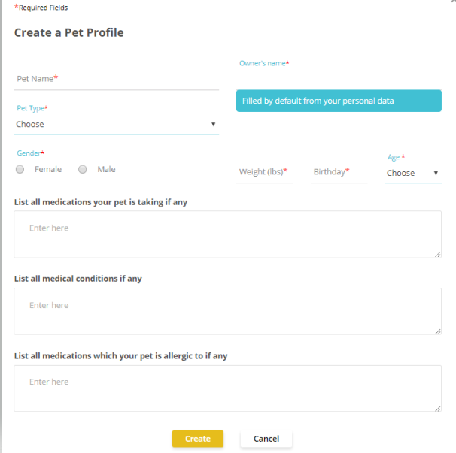
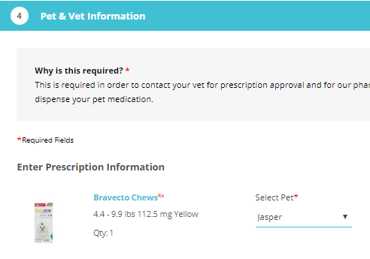
How to place an order
Specifying/Adding Pet
As prescription items need veterinary authorization you will need to specify what medication is for which pet.
As the Bravecto is for Jasper, we will need to create a Pet Profile for Jasper
Click on "Select Pet" and then "Add Pet"
Enter the requested information
Click on the dropdown menu to select "Jasper"
Notes:
Transitions
Bullet points match their specified step via an arrow

Slide 36
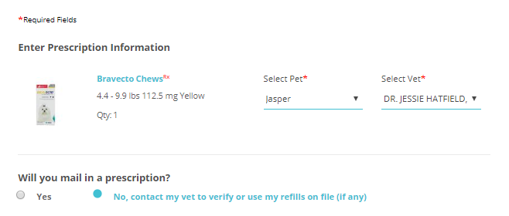
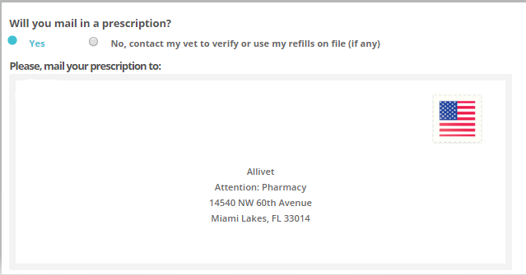
How to place an order
Specifying How to Get Rx
Now that we have specified this prescription request is for Jasper, we need to specify if and how Allivet will be obtaining a valid prescription.
You will see to the right of the pet selection a question “Select Vet”.
Under Pet & Vet Information you will be asked " Will you mail in a prescription?"
Notes:
I want Allivet To Contact My Vet
When selecting “I want Allivet to contact my vet” you will be prompted to enter your veterinary information
I Will Mail My Prescription
When selecting “I will mail my prescription” a pop up will appear advising you as a client where to mail in the prescription.

Slide 37
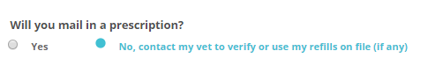
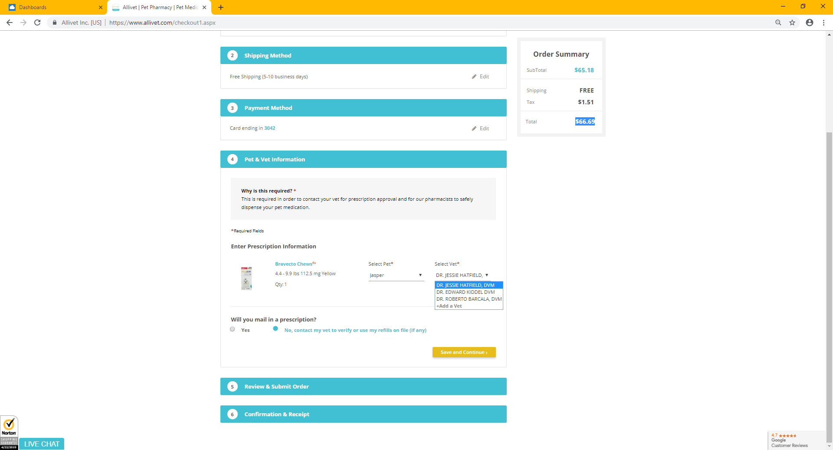
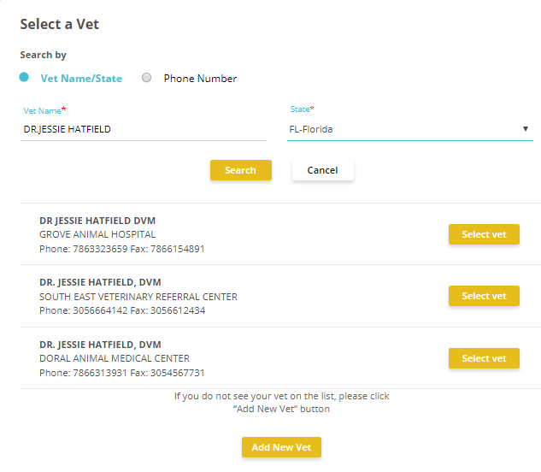
How to place an order
Specifying How to Get Rx
Notes:
Transition Arrows
You will need to enter your primary vet information.
Arrow 1= By clicking on the blue “Add Vet” button a pop up will appear.
- You can search for your vet thorough Allivet’s vet directory.
- You can search via two methods:
Vet Name/Sate
Phone
Arrow 2 = Enter the required information of which ever method you selected and click on the blue “Search Button”
Arrow 3 = When you have found your vet click the blue button on the right that says “Make Favorite”
- This will add them to your vet list

Slide 38
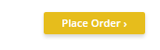
How to place an order
Shipping & Payment
Now that you have added all your items and specified your veterinarian’s information, the order can be finalized.
At checkout you will click on Review & Submit order and click on "Place Order" underneath the notes section.

Slide 39
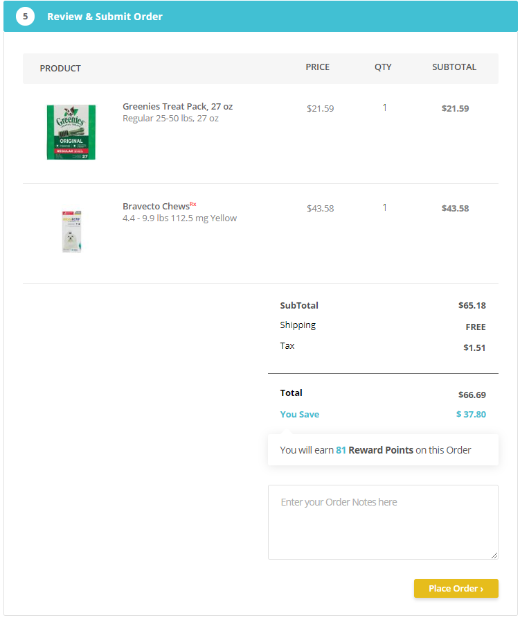
How to place an order
Shipping & Payment
Notes:
Transitions per Panels
Panel 1 = Order Brakedown
Panel 2 = Billing/Shipping
Panel 3 = Payment Information

Slide 40
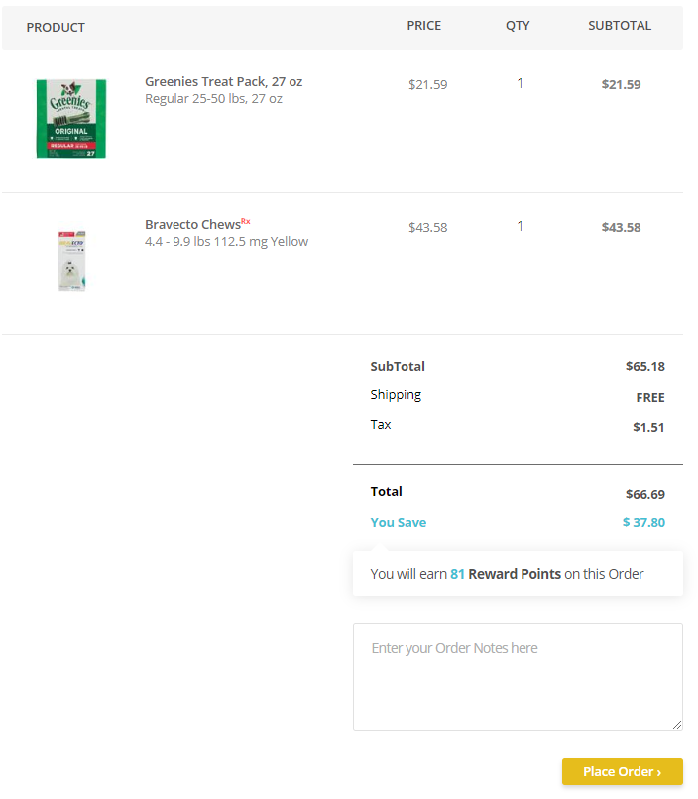
How to place an order
Shipping & Payment
Order Breakdown
You will only be able to see details of your order:
Number of items
Allivet Total Price
Shipping Cost
Taxes
Total
Savings
Reward Points Earned
Order notes can still be entered on this page

Slide 41
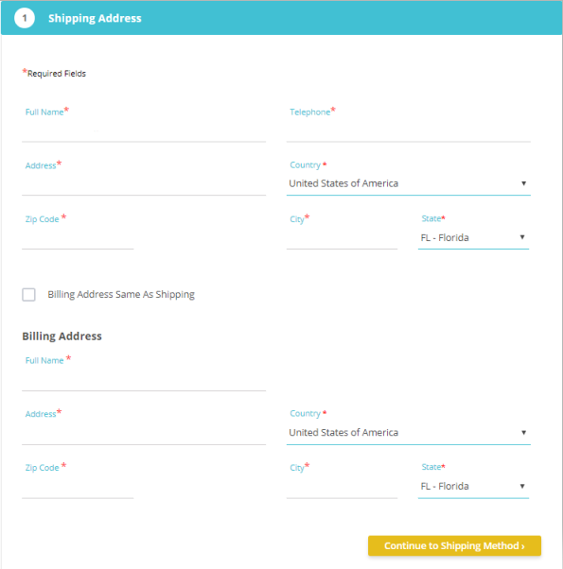
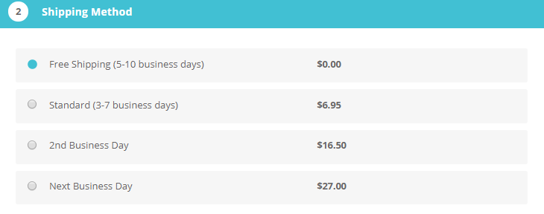
How to place an order
Shipping & Payment
Billing/Shipping
This is where you will specify where and to whom this package is being delivered to.
You can edit both the billing and shipping addresses by clicking on "Shipping Address" during checkout.
You will also be asked to select your shipping method and view shipping charge.

Slide 42


How to place an order
Shipping & Payment
Payment
Here you will enter or select your method of payment.
Under payment method you will see “Saved Credit Card Info”. Saving your CC information allows for easier processing of future orders.
Right below you will see “Add New Credit Card”. Credit card information can be added, edited and deleted here.
You can also view which CC methods qualify to process your order with
You can save this new information by checking the box below that says “Save Credit Card”
Once done, click on the orange button that states "Save and Continue"

Slide 43
Shipping GuideLines

Slide 44




Shipping Guidelines
General Information
All shipping methods are based off business days
Monday-Friday = Business days
Monday-Sunday = Calendar days
Holidays are not considered business days
Saturday deliveries are an additional charge
Clients need to call Customer Service to request this option
Not every city qualifies for Saturday delivery
Free shipping is offered to MOST orders over $49.00
Excludes
Cold Shipped Items
International Orders
Non-Continental States
Hawaii
Alaska
Us Territories
Puerto Rico
Notes:
Use the Calendar image to visually explain how the business days work to how it works with a holiday.

Slide 45

Shipping Guidelines
Cold Shipping
As some items are temperate sensitive these items have a different shipping method called Cold Shipping.
This shipping method is an Automatic Next Business Day order.
It is packed with cold packs
Customers can request regular order to be shipped with cold packs.
This request is an additional charge of $5 per cold pack
ONLY offered Monday-Thursday
Items are that need to be cold shipped are indicated by a blue thermometer
Notes:
Any items placed on Friday-Sunday will not ship until the following business day being Monday or Tuesday

Slide 46

Shipping Guidelines
Restricted Product Zones
Some items have zone restrictions and cannot be shipped to specified states.
Any item with zone restrictions will be indicated within the item description in red lettering
There is NO exception to this rule.

Slide 47


Shipping Guidelines
Carriers
Allivet only uses two shipping carriers:
United Stated Postal Service
Federal Express
Our free shipping is done via the US Postal Service.
Any expedited item will be shipped using Federal Express.
Orders over 2 pounds are also shipped using Federal Express. However, they are shipped using Ground shipping.

Slide 48
Payment Guidelines

Slide 49





Payment Guidelines
Payment Methods
Forms of Payment
Allivet accepts three different payment methods:
Credit Cards
American Express
Discover
Master Card
Visa
Paypal
Can only be used for over the counter(OTC) items
Notes:
- At this moment we do not accept any care credit
- We do not pariticipate any rebates

Slide 50
Placing a web order
Post Payment Information

Slide 51

How to place an order
Processing Order
Once you have clicked on “Place My Order” your order will begin to process.
The portal will indicate the processing of an order with a blue rotating circle.

Slide 52

How to place an order
Order Confirmation
Notes:
Transitional Arrows
Once your order has been completely submitted you will be directed to a new page with all your confirmation information.
Arrow 1 = Order Number
Arrow 2 = Customer Id
Arrow 3 = Allivet Contact Information and Hours
Arrow 4 = Advise you of what email address this confirmation email has been sent to
Arrow 5 = Write a what made you choose to purchase your specified products

Slide 53

How to place an order
Exercise
In this exercise you will create an account and place an order for two Rx items using two different pets.
Trifexis for Riley
Heartgard Plus for Sally

